Slide 1
Explainable Reasoning over Knowledge Graphs for Recommendation
Xiang Wang,^{1∗}Dingxian Wang,^{2†}Canran Xu,²Xiangnan He,³Yixin Cao,¹Tat-Seng Chua¹
¹School of Computing, National University of Singapore,²eBay
³School of Information Science and Technology, University of Science and Technology of China
汇报人：陶佳 论文来源：2019AAAI

Slide 2
01
INTRODUCTION
CONTENTS
02
METHOD
03
EXPERIMENT

Slide 3
01
PART
INTRODUCTION

Slide 4
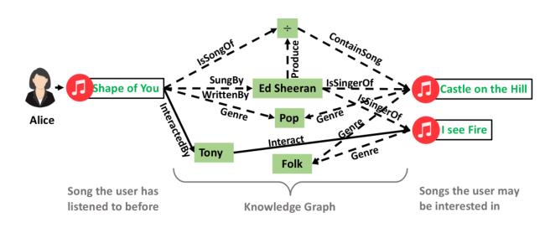
Introduction
Extra user-item connectivity information derived from KG endows recommender systems the ability of reasoningand explainability.
(Alice, Interact, Shape of You)∧(Shape of You, SungBy, EdSheeran)
∧(Ed Sheeran, IsSingerOf, I See Fire)⇒(Alice, Interact, I See Fire).

Slide 5
Introduction
Problems in introducing knowledge graph into recommendation：
existing efforts have not fully explored this connectivity to infer user preferences, especially in terms of modeling the sequential dependencies within and holistic semantics of a path
Knowledge-aware Path Recurrent Network (KPRN), which not only generates representations for paths by accounting for both entities and relations, but also performs reasoning based on paths to infer user preference

Slide 6
02
PART
Method

Slide 7
Method

Slide 8
03
PART
Experiment

Slide 9
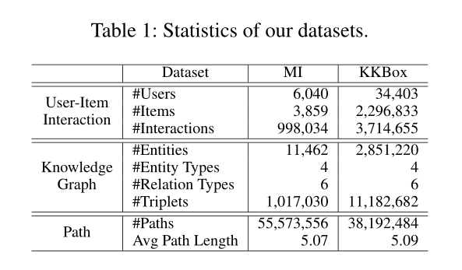
Experiment

Slide 10
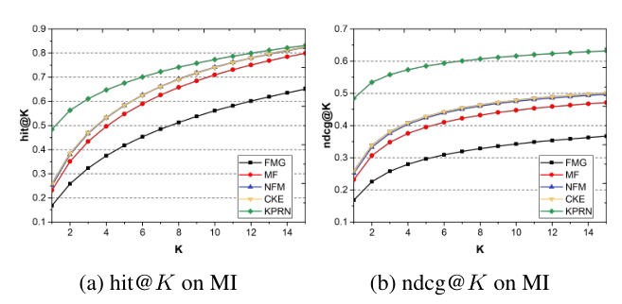
Experiment

Slide 11
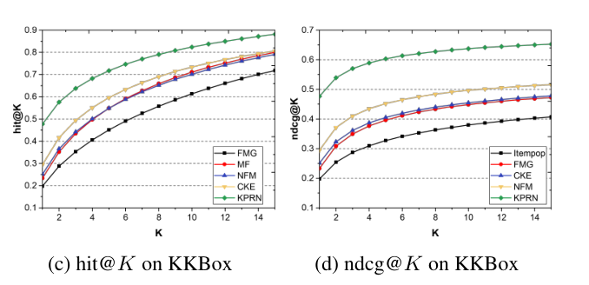
Experiment

Slide 12
Experiment

Slide 13
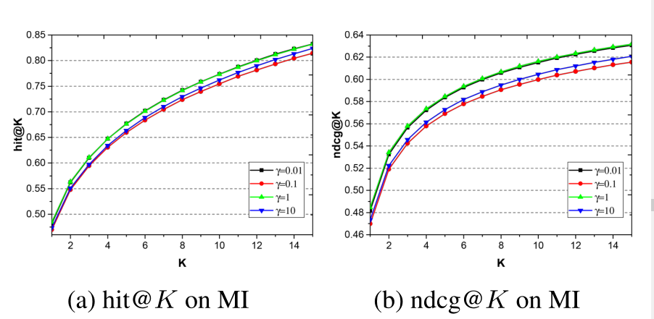
Experiment

Slide 14
THANKS

